Slide 1
Ordinary Persons on the Common Way
Understanding Xaverian Spirituality

Slide 2
Directive of the 26th General Chapter on Mission Formation
As a Congregation in mission, we need to reflect on the unfolding Xaverian mission and how we respond to it….We ask that an international commission be established to continue to promote the study and explication of our Founding Vision and Charism and its on-going implications for the life and mission of the Congregation. A goal of this commission would be to provide a compelling articulation of
Ryken’s vision, his choice of Francis Xavier as patron, and our congregational identity for our use in programs in initial and on-going formation. Furthermore, this articulation will inform the ministry of the Brothers and their collaborators as we respond to the needs of the Church and the world today.

Slide 3
K e r y g m a t i c F r o n t i e r  S o c i a l V i s i o n  M i n i s t e r i a l I n c l i n a t i o n s 
Ecclesial Identity  Intraecclesial Relationship  Ecclesiastical Connection 
Vow Actualization  Interrelational Vision  Intercultural Enrichment 
T r a n s c e n d e n t A s p i r a t I o n s 

Slide 4
T r a n s c e n d e n t A s p i r a t I o n s 
Spirituality Coordinate

Slide 5
Spirit’s Inspirations
Ryken’s Transcendent Aspirations
Brothers’
Transcendent Aspirations
Xaverian
Spirituality
Formation of a Congregational Spirituality

Slide 6
Reconsidering Spirituality
Spirituality can involve pious practices and devotions but these are means to achieving a spiritual state, not the ends.
In its most extraordinary form, spirituality could involve “visions,” “interior locutions,” or other out-of-the-ordinary experiences. In its most personal form, it may involve a consoling personal experience of God. But these are peripheral events which are not the deeper manifestations of spirituality.
Spirituality is not about acquiring prayer or meditation techniques that are in vogue.
“Spirituality could be understood as a way of consciously striving to integrate one’s life through self-transcending knowledge, freedom and love in light of the highest values perceived and pursued.” (Michael Downey, Understanding Christian Spirituality)

Slide 7
Reconsidering Spirituality
a person’s authentic quest for the Ultimate (or, in certain religious traditions, the highest Ideal or the highest Goal), and ,
his/her progressive, consciously-pursued integration through self-transcendence within and toward the horizon of the Ultimate.
“If the Ultimate concern is God revealed in Jesus Christ and experienced through the gift of the Holy Spirit within the life of the Church, one is dealing with Christian spirituality.” (Sandra Schneiders, “Spirituality in the Academy,” in Bradley C. Hanson, Modern Christian Spirituality, p. 23)

Slide 8
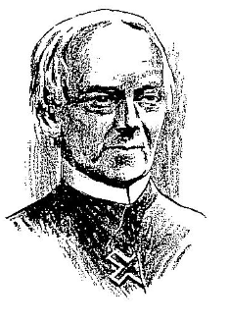
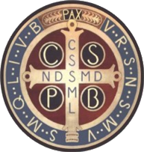
Special Spiritualities refers to “schools” of spirituality developed from certain Catholic religious traditions – Benedictine, Franciscan, Carmelite, Ignatian, etc. – which are strongly influenced by the spiritual apprehensions of its founders and mystics.
“Spiritual masters are influenced by one another at least indirectly. There is among them some kind of intersubjective validation; they confirm many of each other’s experiences and insights.” (Adrian van Kaam, In Search of Spiritual Identity)
Other congregations would be founded that would adapt part or most of the teachings and practices of one (or even several) Special Spirituality… but not its entirety.
Special spiritualities were further developed by the followers of Spiritual Masters after their death.
Special Spiritualities did not arise in an instant

Slide 9
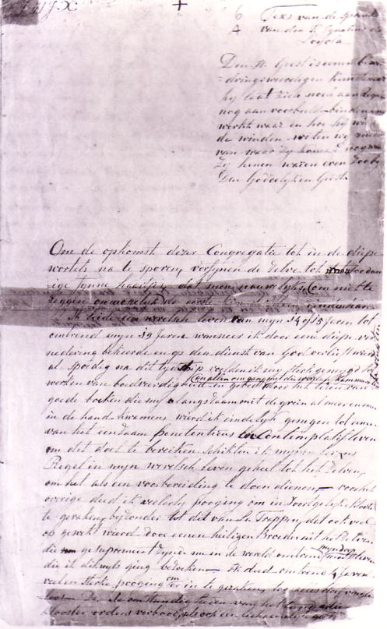
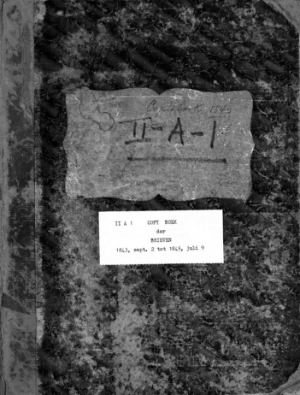
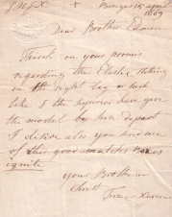
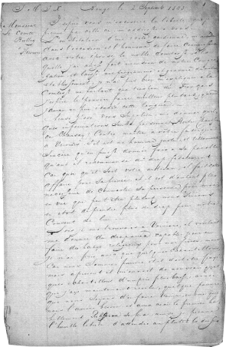
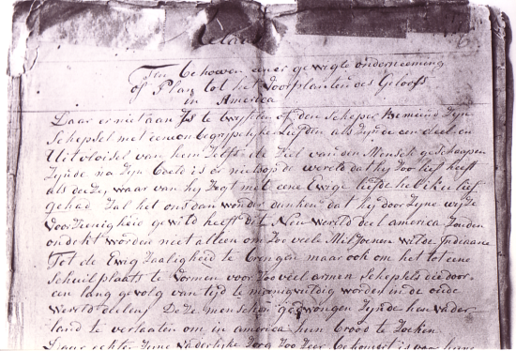
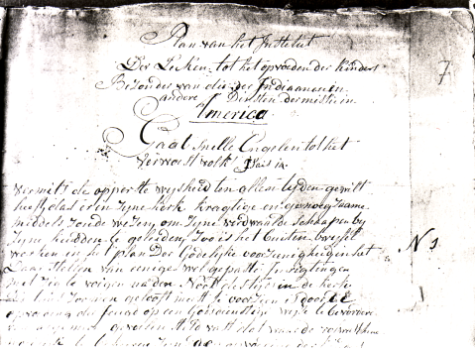
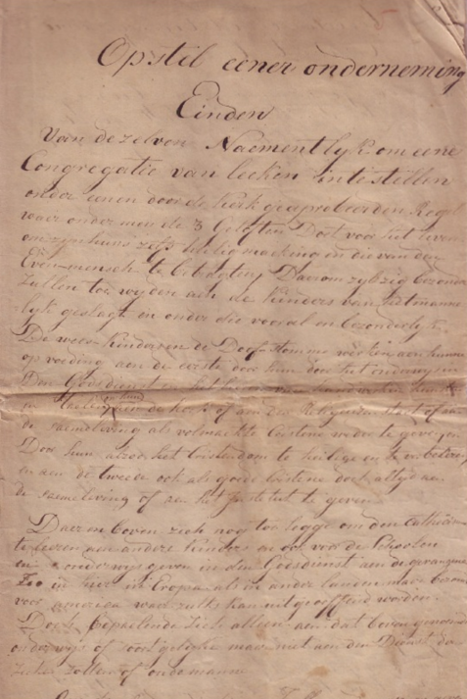
Locating Ryken’s Spirituality
Autobiography (autobiografische schets) written in Brabantian Dutch
Letters (brieven) , including around 1,390 letters compiled in five volumes of which at least 324 (all in German) have never been translated and studied
Foundational Documents (Relaas, Plan, Opsteil) written in Brabantian Dutch

Slide 10
Special Spirituality and Personal Spirituality
“Personal spirituality is a person’s unique articulation and living of a Special Spirituality. For example, not all Dominicans are alike. Even those who live the Dominican spirituality will necessary live it in their own way. There is no avenue of spiritualization for the individual and the community than the personal way. A community of religious or lay people is only as spiritual as its individual members. We cannot spiritualize a community en bloc…. The spiritualization of a group only takes place in and through the spiritualization of the persons who make up the group.” (Adrian Van Kaam, In Search of Spiritual Identity, p. 24)
“We don’t have to deny our own personalization of spirituality, but we must avoid universalizing it. We may show while speaking how we personally live a Special Spirituality, yet we must make it clear that this is how we do it. (Adrian Van Kaam, In Search of Spiritual Identity, p. 25)

Slide 11
Foundational Aspects of Xaverian Spirituality

Slide 12
Ryken’s Primordial Spiritual Awakening
through a deep humiliation, I was converted and fell in love with the service of God
vernedering: degradation, i.e. to be put in one’s place
bekeerde: turn oneself (toward God)
verlieft wierd: to fall in love (with God)
op den dienst: (to put oneself) at the service (of God)
after strongly being put in my place, I turned toward God, fell in love with God, and put myself in God’s service
…door eene diepe vernedering bekeerde en op den dienst van God verlieft wierd

Slide 13
Ryken’s Experience in the Light of Middle Dutch Mysticism
“God is a common good (ghemeyne goet), whose fathomless love is common to all people – pagans and Jews, good and evil. … But even if God’s love is common to all, the shoot of God’s grace is not planted in all. Three things are necessary for this to happen: the prevenient grace of God, a will freely turned to God, and a purification of conscience.” (Jan van Ruusbroec, Die geestelike brulocht, 74-78; 88, 96-97; 100-103)
after strongly being put in my place, I turned toward God, fell in love, and put myself in God’s service…. I became strongly inclined to works of penance and to prayer, avoided the company of worldly companions, (and) read good books which slowly and gradually came more and more into my hands.

Slide 14
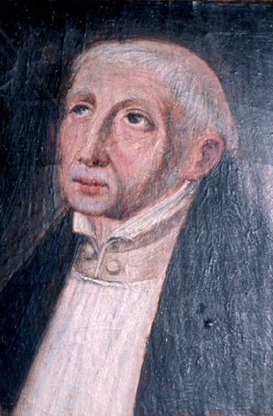
Ryken’s Experience in the Light of Middle Dutch Mysticism
For Jan van Ruusbroec, the highest level in the quest for the Ultimate is the ghemeyne leven – the “common life” which is (1) a person’s self-less “union beyond distinction” with God’s knowing and loving, and (2) the life of harmonious integration of ministry and contemplation .
Ryken envisioned that the deeper Life of the brotherhood will enable its members to become “privileged to follow the two lives of Martha and Mary” (bevoorregt de twee levens te kunnen volgen van Marta en Maria) (Plan § 61)
More than likely, the aspiration to achieve the ghemeyne leven could never be fully realized in one’s earthly life. But it could become the horizon of the Ultimate toward which one’s spirit, soul, and body are directed.

Slide 15
Ryken’s Experience in the Light of Middle Dutch Mysticism
In the “active life,” a person freely turns toward God and works at a life of increasing virtue
In the “inner life,” a person experiences rest in the “ordinary” being of his/her spirit through which God gives the fullness of His divine self.
ACTIVE LIFE
[werkende leven]
INNER LIFE
[innighe leven]
COMMON LIFE
[ghemeyne leven]

Slide 16
Affective Conversion in Xaverian Spirituality (Active Life)

Slide 17
“Vernedering” = Put in One’s Place
Prevenient grace = God’s love is common to all, even before human beings decide to love God.
“God gives a person glimpses (blicke) into his/her spirit, just like lightning in the heavens. These glimpses come as a brief flash (blic) of particular brightness, shining through the person simple bareness, elevating his/her spirit in the wink of an eye (oghen blicke). Then suddenly, the light is gone and the person comes back to his/her usual self.” [Jan van Ruusbroec, Die geestelike brulocht , 348-51]
“We should be most careful to sense the grace and visitations of God. (vandinge godes).” [Johannes Brinckerinck, Collacien: Van der Berkeringhe]
This touch of God (rueren gods) can come in many form – sickness, disgrace, being stirred by sermons or good examples… All of them puts the person back into his/her place, to be situated in one’s ‘ordinary’ yet graced ground (gront).

Slide 18
“Bekeerde” = Turn toward God
Unlike the understanding of conversion in evangelical Christianity, “turning toward God” is understood as a whole way of life = redirecting one’s vision “from the things of this world to facing God.”
“(Ryken) came to the understanding that a continual conversion is needed.” (Fundamental Principles)
“When a person stands empty of evil will and deeds (quaden wille ende werken) and in dread as to what she should do as she turns toward God, then there arises a natural sorrow for sin and a natural good will.” (Ruusbroec, Die Geestelike brulocht, 131-35)
Turning toward God is the person’s response to prevenient grace: “It is the soul’s work, the free conversion of one’s will, in the wink of an eye.” (Ruusbroec, Die Geestelike brulocht, 124-25)
“You have freely chosen to respond to the call of God to live a life of love in faith and trust.” (Fundamental Principles)

Slide 19
“Verlieft wierd” = Falling in Love with God
In the Middle Dutch Mystical tradition, the focus of love (liefde) is God, not good deeds - even if they are done for God.
A tradition that is unapologetically affective and mystically sensual: “Natural, worldly love mirrors divine love. There are stages before we arrive at the kiss of mouth. The first is a loving gaze, and here love takes root. After this, there is a loving conversing…. If you desire to be kissed with the kiss of God’s mouth you should practice loving gazing. Make use of the reasonable eyes that God has given you to perceive him.” (Willem Jordaens, De oris osculo)
“The first address to God in the morning: ‘My Beloved, who are you? You are the one, eternal, immutable, supreme God. Now I give myself once again entirely to you.” (Die Evangelische Peerle)
“To the one who turns toward Him, Christ casts his divine rays into his/her heart’s yearning avidity and lust for God. The lusty, open heart, and the shining of divine rays within it, produce an affliction. In inner impetuosity, one is prepared to suffer all that can be suffered in order to obtain what one loves.” (Jan van Ruusbroec, Die Geestelike Brulocht, b436-40)

Slide 20
“Verlieft wierd” = Falling in Love with God
Bekeerde can also be seen in Ryken’s firm insistence that his brothers should forego of any enterprise that would prevent them “from working at their perfection and spiritual exercises.” (Opstel §11)
“I hope you will be patient till then and that at that time we will be able to solve your problems. Meanwhile be patient and above all do not think that I look upon you as a stranger with no connection with us. Remember that I often have you in mind and that my one wish is to have you with us very soon.” (Letter of Theodore James Ryken to Francis Xavier Dondorff , 20 December 1849)
“The Brothers are espoused to Christ by virtue of their religious profession.” [Constitution and Holy Rule of the Xaverian Brothers, 1900 (part I, ch. 5, art. 3, par.1)]

Slide 21
Ordinary Resolution in Xaverian Spirituality (Inner Life)

Slide 22
Resolution
“Placing oneself at the service of God (en op den dienst van God)” is not a functional statement…. Rather it is an act of rendering to God a life of resolution.
“Making a good resolution (een goede opzet maaken) was at the heart of the process of turning toward God. To the New Devout , the practice of resolution entails a changing of one’s status in life.” (John van Engen)
“If you allow yourself to be formed by God through the common, ordinary, unspectacular flow of everyday life, you will gradually experience a liberation and a freedom never before imagined. (Fundamental Principles)

Slide 23
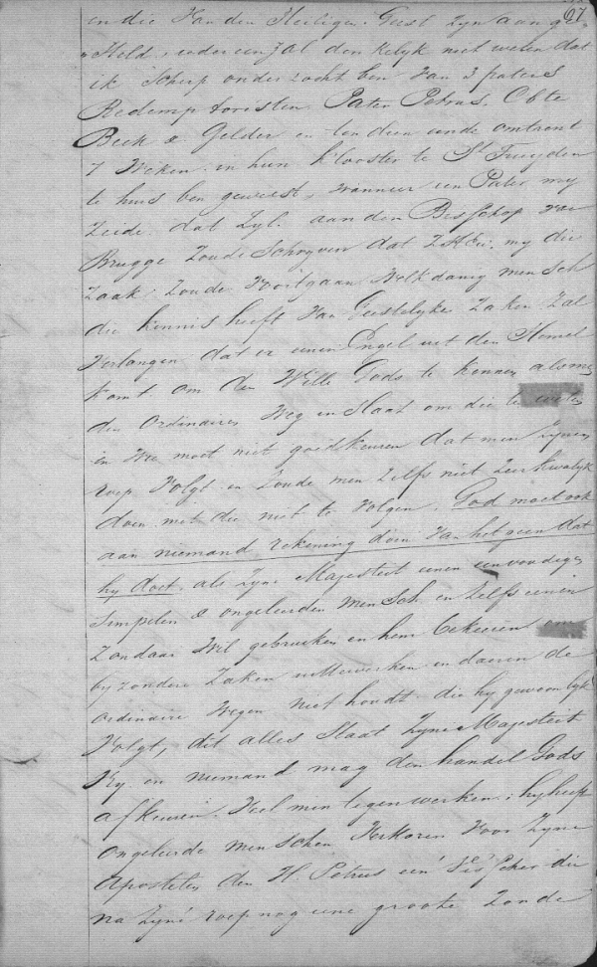
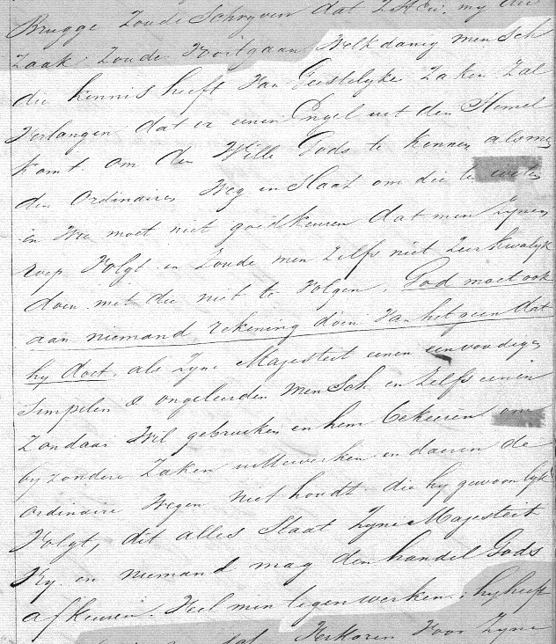
If you allow yourself to be formed by God through the common, ordinary, unspectacular flow of everyday life…
“Which person who has some experience of spiritual matters would desire that an angel come from heaven in order to make known God’s will, when it is possible to know it by following the common way (ordinaire weg)? Are not all obliged to follow their vocation? Would it not be quite wrong not to follow it? God does not have to give an account to anybody of His actions. If His Majesty wants to use an ordinary (eenvoudige), simple and uneducated person – yea, a sinner; if God wants to make this person turn toward (bekeeren) Him in view of a special work; if God does not take the direction which He usually follows. In all this His Majesty is completely free.”
(Ryken to G.N. Hermans, 14 November 1844)
Indien je aanvaardt door God te worden gevormd door middel van het gewone, eenvoudige, onopvallende leven van elke dag…

Slide 24
“Eenvuldicheit” : Ordinariness
“In the beginning of the holy Church and of our faith, popes, bishops, and priests were common…. But now everything is just the contrary. For those who now possess the inheritance and the rents which were given out of love and for their holiness are unstable in their ground. They are unappeased and manifold for they are totally turned towards the world, and they do not thoroughly consider the things or the matters which they have in their hands. Therefore they pray with their lips, but their heart does not savor what it speaks about…. They do not feel it at all. That is why they are so coarse and obtuse and unenlightened in divine truth. Some seek to eat and drink well and to have bodily comfort in an unseemly fashion – and would to God that they were pure of body! As long as they live in this way, they will never be enlightened.” (Jan van Ruusbroec, Die Geestelike brulocht, b1116-26)

Slide 25
“Eenvuldicheit” : Ordinariness
Molded in the life form of religious brotherhood, Xaverian ordinariness is marked by a wariness with privileges and entitlements. In its deepest practice, it calls for an enlightened renunciation of the privileged and entitled life.
“The most ordinary persons are those who are the most satisfied and most at peace with themselves. They are the most deeply immersed in God (and) good works, and the most wide-ranging in the way their love flows out to all in common. They are the least hindered in love , for they are the most God-like. The more we are united with God, we remain grounded in the ordinary, consider all things with enlightened reason, and flow through everything with common love.” (Jan van Ruusbroec, Die geestlike brulocht, b1767-72)

Slide 26
Eenvuldicheit: Ordinariness
Two polarized delusions of Ordinariness:
on one hand, the ordinary elicits fear among those who have bought in to the media-fed notion that what one should aspire for is the glamorous and bourgeois lifestyle;
on the other end, there are those who equate the ordinary as the mediocre, making a virtue of achieving what is only the middling when, sadly, they are tragically giving in to physical, spiritual, and intellectual laziness.

Slide 27
Eenvuldicheit: Ordinariness
To be ordinary for Ryken is to be grounded in one’s giftedness: “(Our formation) will try to detect every person’s character and temperament, his natural and supernatural gifts. His weaknesses should also be known so that, in a balanced manner, measures can be taken so that the profitable capacities to which he is well-inclined would be promoted instead. On knowing his capacities, everything should be ordered in such a way that these may be developed so that he may successfully fulfill the tasks that are assigned to him. In so doing, the little members of this whole body as well as the great, the weak as well as the strong, may act harmoniously with each other. Through this, powerful works may then be produced through this body.” (Plan, § 13)

Slide 28
Eenvuldicheit: Ordinariness
There are some people whom God takes and sets apart. There are others he leaves among the crowds, people he does not “withdraw from the world.” These are the people who have an ordinary job, an ordinary household, or an ordinary celibacy. People with ordinary sicknesses, and ordinary times of grieving. People with an ordinary house, and ordinary clothes. These are the people of ordinary life. The people we might meet on any street. They love the door that opens onto the street, just as their brothers and sisters who are hidden from the world love the door that shuts behind them forever. We, the ordinary people of the streets, believe with all our might that this street, this world, where God has placed us, is our place of holiness. We believe that we lack nothing here that we need. If we needed something else, God would already have given it to us (Madeleine Delbrêl, Nous autres, gens de la rue, 1938)

Slide 29
Disposition: Single Intention
“Single intentioned” (pure of heart) = eenvoldighe meyninghe, literally, “ordinary intention”
“Each good work, no matter how small it is, which is borne into God with love and uplifted, single intention, merits greater likeness and eternal life in God…. An intention is single when it intends nothing but God and all other things in relation to God. A single intention drives out hypocrisy and duplicity. A person should retain and practice such an intention above all else in all his works, for it keeps a person in God’s presence, clear in understanding, zealous in virtues, and free of needless fears…. A single intention is the fervent, enlightened, loving inclination of the spirit. It is the foundation of all spiritual life.” (Jan van Ruusbroec, Die Geestelike Brulocht)

Slide 30
Disposition: Rest
“Rest” in God is “enjoyment of God’s unity” (ghebruken)
Grounded in single intention, we go beyond or transcend ourselves, meet God, and rest with God in enjoyment on the ground of ordinariness.
“We keep oneness with God above our activity, in bareness of our spirit in divine light, where we possess God above all virtues in rest. For charity in the likeness must be eternally active, but oneness with God in enjoyable love will be forever at rest. And this is what it is to love. For in one now, in one instant, love acts and rests in its beloved. The higher the love, the more the rest; and the more the rest, the more inner the love.” (Jan van Ruusbroec, Die geestelike brulocht)
“This is what it means to comprehend God in an incomprehensible manner, that is undergoing and not comprehending.” (Jan van Ruusbroec, Van den XII beghinen)

Slide 31
Contemplative Direction in Xaverian Spirituality (Common Life)

Slide 32
Ghemeyne Mensche: The Common Person
In the Middle Dutch mystical tradition ordinariness is the prerequisite for transformation of an individual into a ghemeyne mensche (the common person)
“The common person is unspectacularly ordinary, empty of any complacency and filled with love for every vulnerable being, big and small. Familiar with the ways of the world and uniquely ‘all-around’, the common person is thoroughly human, notwithstanding the unparalleled energy that sustains and pushes him forward.” (Benoît Standaert, De Jezusruimte: verkenning, beleving en ontmoeting)
The common person = one who is able to harmoniously integrate a life of ministry and a life of contemplation.

Slide 33
Ghemeyne Mensche: The Common Person
The common man is sent by God down from the Transcendent heights into the world…. He seeks nothing for himself but only the honor of the One who sent him, and therefore he is just and true in all his actions. He has a rich, mild foundation which is grounded in the wealth of God, and therefore he must always flow into all those who need him, for the living fountain of the Holy Spirit is his wealth which cannot be exhausted. He is a living, willing instrument of God with which God does what he wants, the way he wants. He does not claim this for himself, but gives the honor to God. Therefore, he remains willing and ready to do all that God commands. He is strong and courageous to suffer and bear all that God allows to befall him. Thus, this common man has a common life (ghemeyn leven), for contemplation (scouwen) and action (werken) come just as readily to him and he is perfectly at ease with both. No one can have this common life unless he is a contemplative man (scouwen mensche). (Jan van Ruusboec, Vanden Blinkenden Steen)

Slide 34
Ghemeyne Mensche: The Common Person
We want to give now our attention to the total picture of this present plan and consider two excellent qualities which will be found in this Congregation and which are considered to be great in the Church, namely the contemplative and active lives. In fact, if it is God’s pleasure to lift our proposed plan to that very height that we intend and of which we hope that it is pleasing to Him, then the members will have the privilege of following both the lives of Martha and Mary. In fact, by living the religious state and following its exercises, such as prayer and meditation, they follow Mary in the contemplative life, while by catechizing children and older people and working at those people’s salvation, they follow Martha in the active life. (Plan §61)

Slide 35
In a gist….
We Xaverians are sons and daughters of a man who beheld within him – once and continually – the crucible of human experience: certainty and uncertainty of one’s deeper calling; fidelity and infidelity to one’s resolution; satisfaction and dissatisfaction with the real.
Without a doubt, Ryken came to an awareness of a life direction for him (and his followers) – the non-dichotomized life of Martha and Mary, the ghemeyne leven – and aspired to achieve that lofty purpose;
Incarnating that aspiration occurred, however, within the ground of his graced humanity.
It was an “ordinary” graced humanity in two ways: (1) self-determined to be without privilege and entitlement, and (2) open to the constant yet surreptitious irruptions of God in the unspectacular flow of daily life.

Slide 36
In a gist….
The first way to ordinariness was a resolution he took on. It was difficult to make, but Ryken resolved to take it with “single intention”;
The second way to ordinariness was the mystery he would be summoned to turn toward through all his life. It was difficult to make but Ryken was undoubtedly self-disposed to stand ready before the inscrutability of God’s ways and to rest in adoring them: “O Heere, ik kan Uw wegen niet begrypen, maar moet die aanbidden” (Letter to Marie-Jeanne de Knuff, baroness d’Osy, 20 September 1843).

Slide 37
Reflection Questions
When have I experienced being “put in my place” in a way that became formative or transformative for me?
When did I experience a significant moment of turning towards God and how am I now being asked to turn more completely toward God?
At this time in my life, what does it mean to me to be in love with God?
When can I remember making a deliberate choice to reject privilege and entitlement?
What would most help me to deepen my way of living as a “common person”, as attuning to the Divine presence and call in each moment of my life?

